Slide 1
Topological Models for Safety Analysis
Dan Maljovec
8/29/18

Slide 2
Problem Space Description
Input Parameter Candidates
+ Target Output(s)
Scientific Discovery
Analyze
Synthesize
Explore
Scientific Discovery
Enhanced Approximation or Theory
Notes:
So, scientific research at its most basic level is about observing phenomena occuring in nature and our surroundings through relationships of different quantities of interest. For our purposes, we are interested in studying the relationship between some input parameters that we have direct control over and observable target outputs, we believe to be correlated to a subset of those inputs. We perform our experimental design and the end result is some enhanced approximation or theory about the relationship.
We are interested in what is happening in this middle box, so if we lift the covers and look a bit more closely we see three major componenets of the experimental design process: Explore, Analyze, and Synthesize.

Slide 3
Publication List
Rethinking Sensitivity Analysis of Nuclear Simulations with Topology.
Dan Maljovec, Bei Wang, Paul Rosen, Andrea Alfonsi, Giovanni Pastore, Cristian Rabiti, and Valerio Pascucci. Proceedings of IEEE Pacific Visualization (PacificVis), 2016.
Visualizing High-Dimensional Data: Advances in the Past Decade.
Shusen Liu, Dan Maljovec, Bei Wang, Peer-Timo Bremer, and Valerio Pascucci. Eurographics Conference on Visualization (EuroVis), STAR - State of the Art Report, 2015.
ND²AV: N-Dimensional Data Analysis and Visualization - Analysis for the National Ignition Campaign.
Peer-Timo Bremer, Dan Maljovec, Avishek Saha, Bei Wang, Jim Gaffney, Brian Spears, and Valerio Pascucci. Computing and Visualization in Science, 17(1), Pages 1-18, 2015.
Analyzing Simulation-Based PRA Data Through Clustering: a BWR Station Blackout Case Study.
Dan Maljovec, Shusen Liu, Bei Wang, Valerio Pascucci, Peer-Timo Bremer, Diego Mandelli and Curtis Smith. Probabilistic Safety Assessment & Management conference (PSAM), 2014. Extended Journal version: Reliability Engineering & System Safety (RESS), 2015.
Topology-Based Active Learning.
Dan Maljovec, Bei Wang, John Moeller, and Valerio Pascucci SCI Technical Report UUSCI-2014-00, 2014.
Analyzing Dynamic Probabilistic Risk Assessment Data through Clustering.
Dan Maljovec, Bei Wang, Diego Mandelli, Peer-Timo Bremer, and Valerio Pascucci. International Topical Meeting on Probabilistic Safety Assessment and Analysis (PSA), 2013.
Adaptive Sampling Algorithms for Probabilistic Risk Assessment of Nuclear Simulations.
Dan Maljovec, Bei Wang, Diego Mandelli, Peer-Timo Bremer, and Valerio Pascucci. International Topical Meeting on Probabilistic Safety Assessment and Analysis (PSA), 2013.
*First Runner-up for Best Student Paper Award
Exploration of High-Dimensional Scalar Function for Nuclear Reactor Safety Analysis and Visualization.
Dan Maljovec, Bei Wang, Valerio Pascucci, Peer-Timo Bremer, Michael Pernice, Diego Mandelli, and Robert Nourgaliev, in Proceeding of M&C 2013 International Topical Meeting on Mathematics and Computation, CD-ROM, American Nuclear Society, LaGrange Park, IL, 2013.
A Comparative Study of Morse Complex Approximation Using Different Neighborhood Graphs. Dan Maljovec, Avishek Saha, Peter Lindstrom, Peer-Timo Bremer, Bei Wang, Carlos Correa, and Valerio Pascucci. Topology-Based Methods in Visualization (TopoInVis), 2013.
Adaptive Sampling with Topological Scores.
Dan Maljovec, Bei Wang, Ana Kupresanin, Gardar Johannesson, Valerio Pascucci, and Peer-Timo Bremer. Working with Uncertainty Workshop at IEEE VisWeek, 2011. International Journal for Uncertainty Quantification, 3(2), pages 119-141, 2013.
Establish Credibility:
Pubs
OSS
Who is using what you have done
Notes:
Here is a list of my current publications, and for today's talk I am going to focus on talking about only a few of them which I have highlighted here plus some additional yet to be published efforts.

Slide 4
Problem Space Description
Explore
Gather data
Select “important” areas
Analyze
Visualization
Inspect experimental results
Compare experimental to expected data
Detect anomalies
Verify assumptions
Synthesize
Correct assumptions
Build more efficient or more accurate models
Rinse, Lather, Repeat…
Input Parameter Candidates
+ Target Output(s)
Analyze
Synthesize
Explore
Scientific Discovery
Topology
Enhanced Approximation or Theory
Notes:
The process begins with data collection. My focus on this portion of the talk will be on adaptive sampling methodologies.
Next, we have the analysis phase where we traditionally see visualization techniques employed. The range of analysis techniques is quite broad and depends heavily on the goal of the analysis. Today, I will be focus on a very narrow goal of providing interpretable and accurate sensitivty analysis.
The last phase is synthesis. Here, we correct our assumptions of the data in order to build more accurate or more efficient models that we can then feed back into the pipeline for more exploration and analysis.
Tbe important thing to note, is this is a feedback loop, so we can utilize our enhanced model to begin the cycle again.
As suggested in the opening thesis statement, my proposal is to inject topological methods into each phase of this pipeline in order to gain a better understanding of the data.

Slide 5
Background: Topology
Consider the input space as a manifold and the target as a smooth function defined on that space
Utilize Morse Theory to extract structure and features for exploration, analysis, and synthesis
Input Parameter Candidates
+ Target Output(s)
Analyze
Synthesize
Explore
Scientific Discovery
Enhanced Approximation or Theory
Notes:
In order to adapt methods from topology, we make a few assumptions on our data space namely: we consider the arbitray dimensional input space as a manifold, and the target outputs as smooth functions on that manifold space meaning anywhere on the manifold we can evaluate a target response value.
Specifically, we are going to consider a branch of differential topology called Morse theory to augment each of these three components: exploration, analysis, and synthesis.

Slide 6
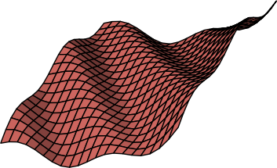

Background: Topology
Manifold
Something that resembles Euclidean space locally…everywhere
Smooth Function
Continuously defined and differentiable
high
f(x)
low
Notes:
To clarify, I want to define a few terms from the previous slide. A manifold is a space that locally resembles a Euclidean space of that dimensionality everywhere it is defined.
In addition, the target responses we are evaluating will be treated as smooth functions defined over the manifolds. This means at any location in the input manifold, the target and its derivative are continuously defined.

Slide 7
Background: Morse Theory
1
3
2
1
2
3
f(x)
Notes:
From Morse theory, we are interested in two key concepts illustrated here. So, consider the terrain on the left as a 2D manifold with height representing the function value. In the top image, we are tracking the evolution of levelsets. That is, when the topology of the levelsets changes. You see on the right image a tree view that shows each leaf as the birth or death of a connected component of the levelset and branches in the tree represent splits and merges of the connected components.
We see the vertical position of each node in the tree represents the isovalue at which that event occurs. So, if we choose an isovalue and cut the tree, we note that each intersection with the dashed line represents a seaparate component of the levelset.
In the lower example, we are showing a Morse-Smale complex which instead partitions the data based on gradient flow. In this example, every location is associated with the source and sink of the integral line that passes through it. So, if we consider the orange partition that is facing us, if we trace the gradient from any location upward we will end up at the blue maximum point occuring in the center of the image. Conversely, if we trace the negative gradient from any location on the orange patch, we will end up at the minimum occuring at the lower right of the image.

Slide 8
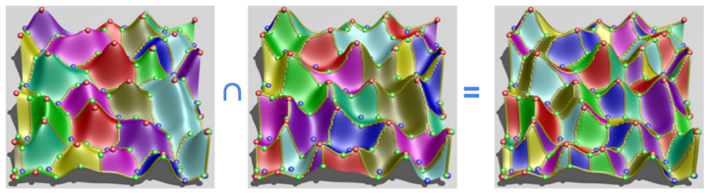
Background: Morse-Smale Complex
Stable/Descending
Manifolds
Unstable/Ascending
Manifolds
Morse-Smale
Complex

Slide 9
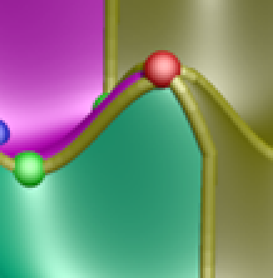
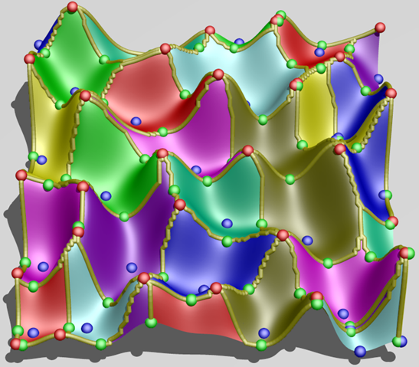

Slide 10
Traditionally:
b. Follow steepest descent from each point in dataset
b. Color points based on minimum where flow halts

Slide 11
What if you don’t have a smooth representation?

Slide 12
What if you don’t have a smooth representation?

Slide 13
What if you don’t have a smooth representation?

Slide 14
What if you don’t have a smooth representation?

Slide 15

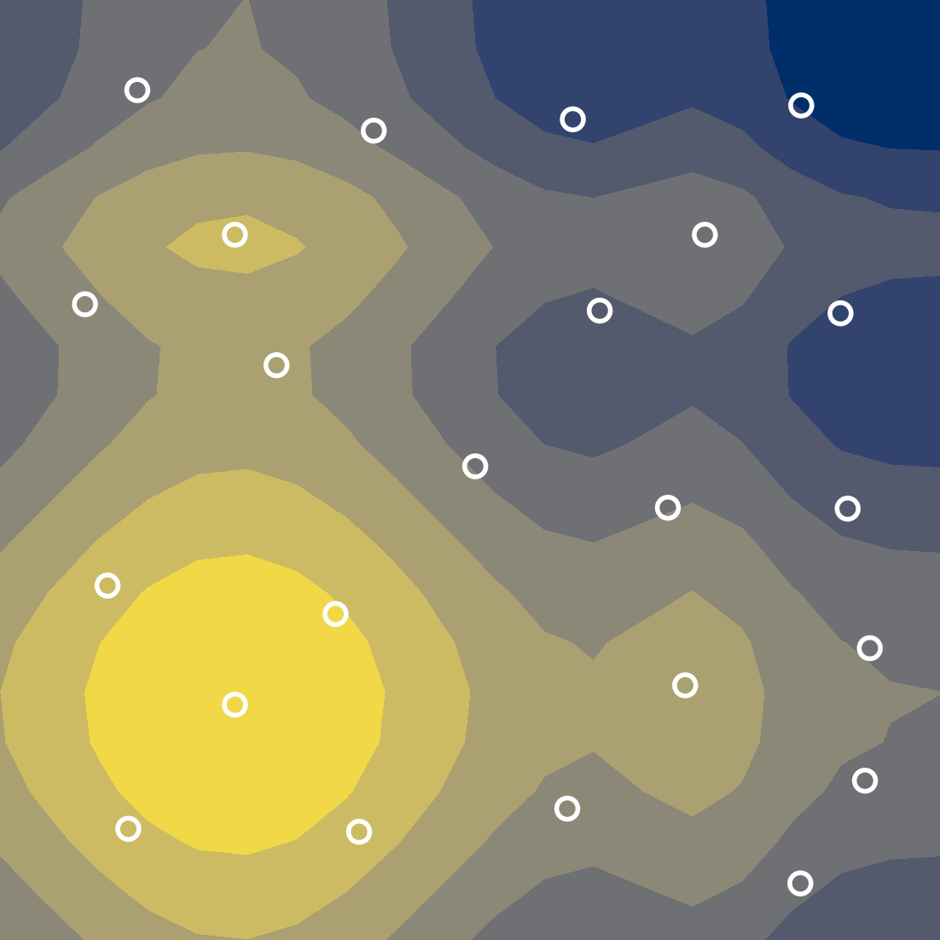
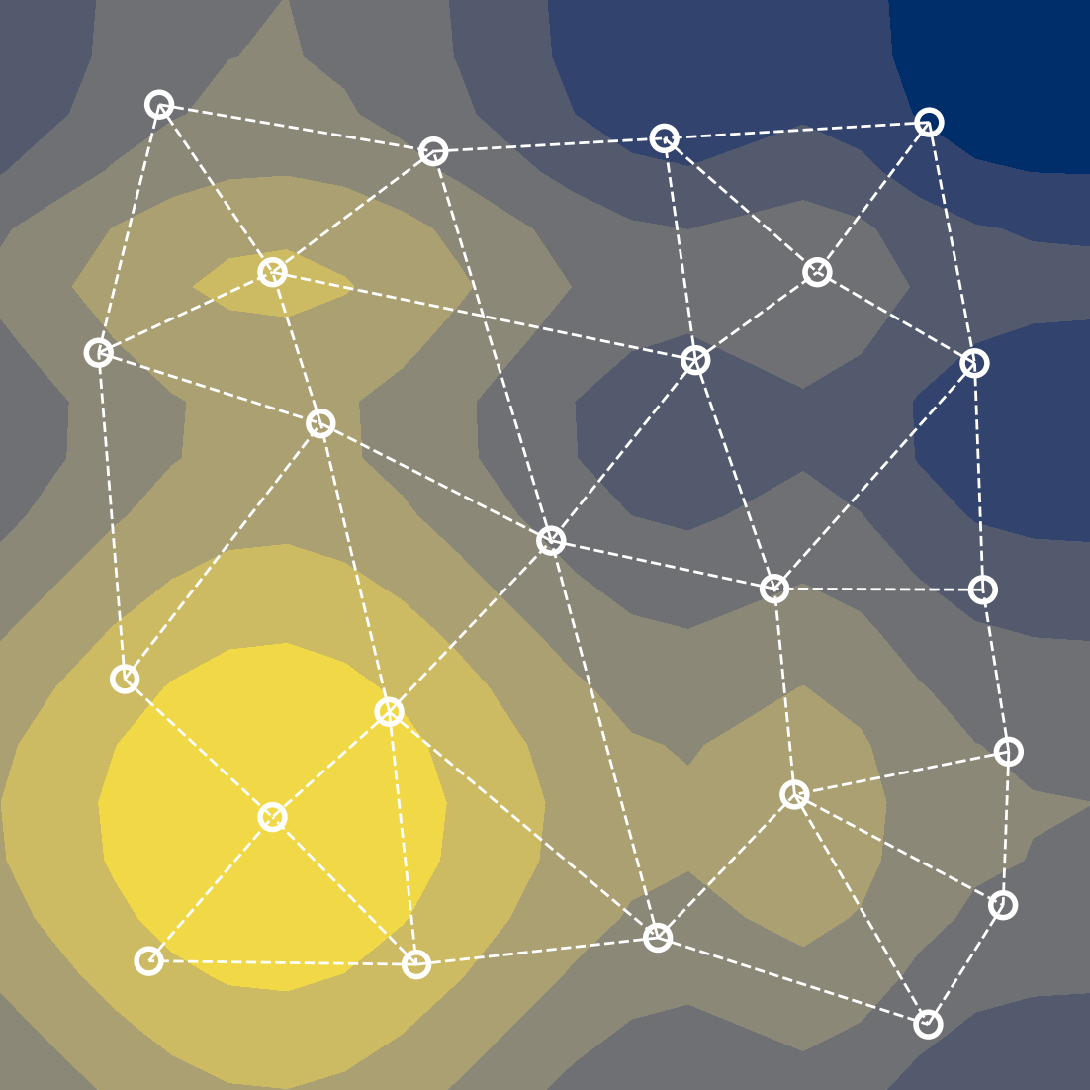
Background: Approximate Morse Complex

Slide 16
Background: Persistence Simplification
Critical Points:
maxima =
minima =
p_{c}
p_{a}
p_{b}
Notes:
A nice feature of the Morse-Smale complex is that we can associate a notion of feature scale. That is we can simplify or smooth away smaller features while maintaining the larger ones to arrive at a less resolved partitioning. This is done through a process known as persistence simplification.
Consider, this 1D function. Basically, we are going to pair neighboring critical points based on their smallest function value difference neighboring critical point (at the time of cancellation), and associate their function value difference as their combined persistence.
In this case, we first pair and cancel the small peak/valley combination on the left of this function.
Next, we pair the larger maximum and minimum together.
Lastly, we pair the local minimum and maximum occurring at the boundaries of the data. Note, that the last pair are not adjacent in the function, but since we have cancelled all of the other critical points they are now considered adjacent.

Slide 17
Explore: Overview
Proposed solutions:
Topology-based scoring
Limit surface sampling
Batch candidate selection
Input Parameter Candidates
+ Target Output(s)
Analyze
Synthesize
Explore
Scientific Discovery
Enhanced Approximation or Theory
Notes:
Okay, so now with the necessary background in hand, we will begin by seeing how we can inject some of these concepts into the exploration phase.

Slide 18
Explore: Challenges
We want the most out of the least amount of information since data is hard to come by:
Expensive
Time-consuming
Dangerous
Data can exist in high-dimensional space:
Exponential increase of volume as dimension increases
Notes:
Given the nature of nuclear energy, it should come as no surprise that physical experimentation can be very dangerous, and so often we rely on computer simulations. However, due to the complexity of the physics we are modeling, collecting copious amounts of data can still be expensive and time-consuming. Therefore, it is to our advantage to extract the most amount of information from the least amount of data.
Furthermore, the input spaces we are interested can be of arbitrary input dimensionality, and from the curse of dimensionality we know that the space needed to sample grows exponentially with respect to increasing dimensionality. So, it is unlikely that we will ever recover a dense enough sampling in high-dimensions to do a meaningful global analysis.

Slide 19
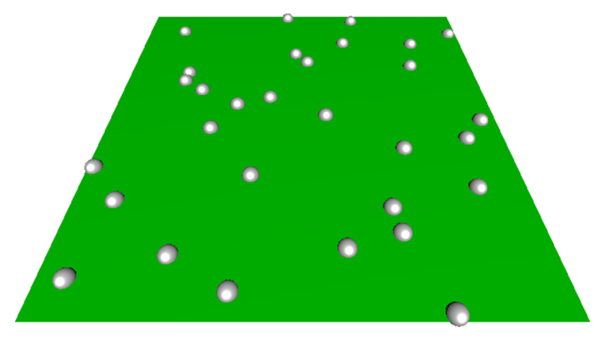
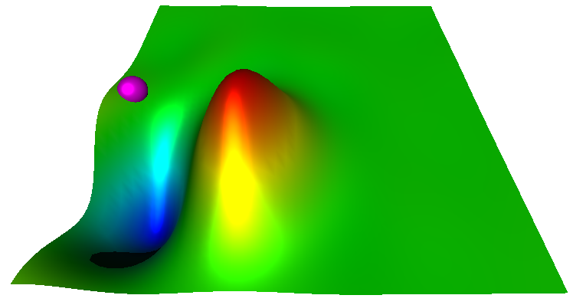
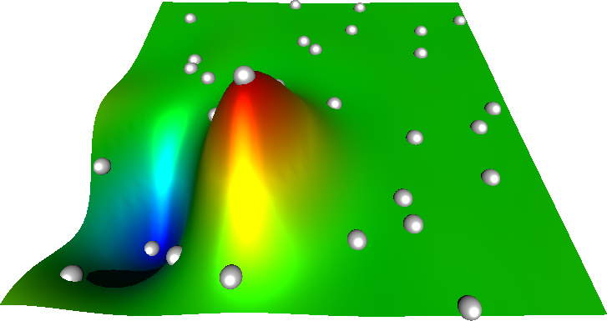
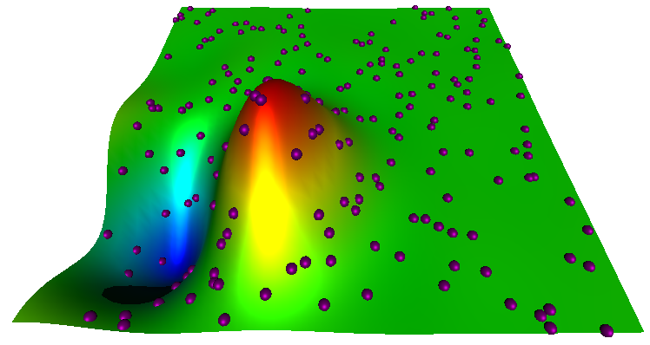
Explore: Adaptive Sampling Pipeline
Run experiment at training location(s)
Fit a predicting model
Generate & score candidates
Select candidate for training
Notes:
Here, I am showing a typical adaptive sampling pipeline used for initial data sampling. We begin with no knowledge of our response value of interest and so select several training data locations based on some space-filling design, and evaluate our ground truth model on it.
We fit a predicting model to the obtained data.
We next generate a pool of candidates and based on information from the predicting model we score these candidates to determine which candidate will give us the most useful information. We then select a candidate, evaluate it using the ground truth, and add it to our training data and repeat the process.
So, of these four steps I want to focus our attention on these last two steps: namely how we score and select candidates for training.

Slide 20
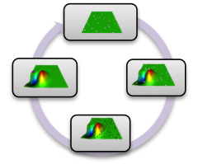
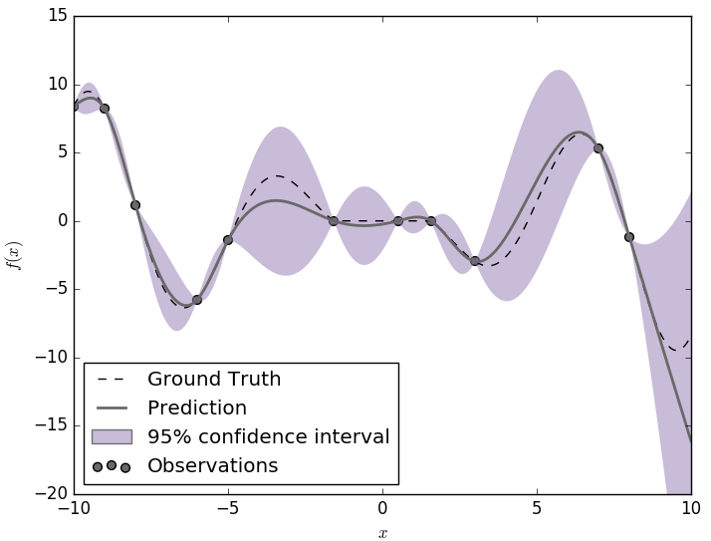
Explore: Scoring Methods
High uncertainty in the current predicting model
Expected improvement (steep gradient + uncertainty)
Topology-based scoring
Notes:
Many predicting models are probabilistic or can be made probablistic by methods such as boostrap aggregating. In this way, we can associate an uncertainty with each location in our input space.
Here, we consider a 1D problem fit with a probabilistic model.
McKay et al. introduced a method geared at targeting highly uncertain regions. So, we can see in this example, that we want to select candidates that have large error bars associated with them. The problem here is that sometimes this methodology can waste effort looking in regions where the predicting model is relatively flat and uninteresting.
Thus, a similar method was introduced later that targets not only uncertain regions, but also areas of steep gradient. This was termed the expected improvement function. In this case, we combine the difference in mean value prediction of a candidate with its nearest neighboring training point with the uncertainty of the predicting model.
This last method starts to get at a key component of adaptive sampling, that is can we avoid "flat" regions and instead place samples where the function is doing something more interesting.
In understanding this concept, we developed several scoring metrics that were more directly geared at this by exploiting the topology ofthe predicting model directly in order to identify areas of high persistence features, or where adding a point will likely affect the overall global topology.

Slide 21
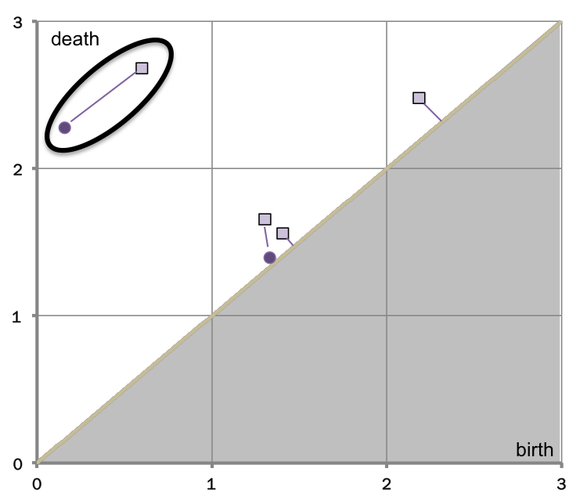
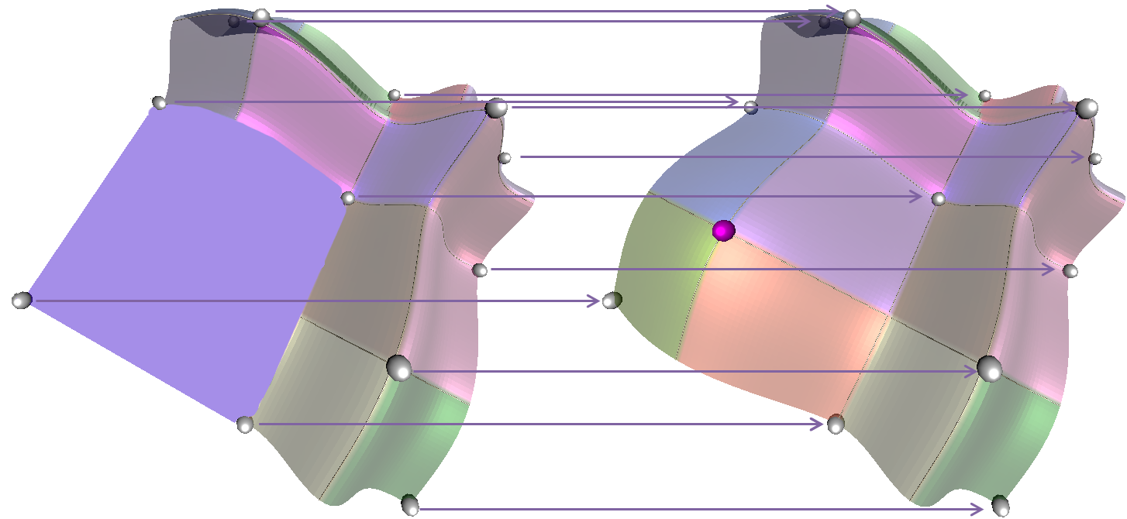
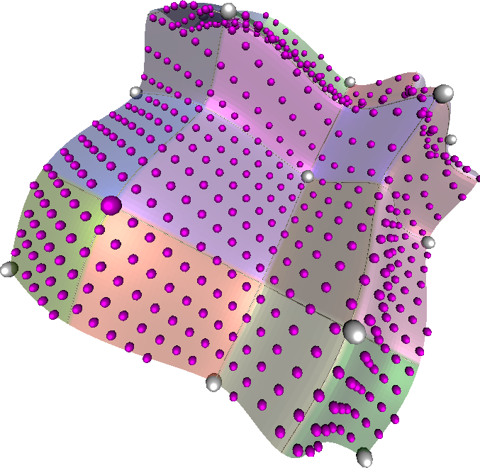
Explore: Scoring Methods
High uncertainty in the current predicting model
Expected improvement (steep gradient + uncertainty)
Topology-based scoring
Global Topological Influence
Local Topological
Influence
Σ(Δp)/n
Adaptive Sampling with Topological Scores. Dan Maljovec, Bei Wang, Ana Kupresanin, Gardar Johannesson, Valerio Pascucci, and Peer-Timo Bremer. International Journal for Uncertainty Quantification, 3(2), pages 119-141, 2013
Notes:
And so, we developed 3 novel scoring functions based on the Morse-Smale complex that attempted to capture these topological changes in different ways: by looking for which candidate globally affected the topology the most, and also by highlighting the most topologically significant candidate.
This work is highlighted in our 2013 IJUQ paper titled Adaptive Sampling with Topological Scores.

Slide 22
Explore:
Notes:
The last step of the general adaptive sampling pipeline is candidate selection. So far, we have assumed the context of selecting one point before refitting. Under parallel settings, though we can see the benefit of being able to execute several ground truth simulations at once especially since these can take hours or days to complete.
For this, we instead focused our attention on the topology of the scoring landscape rather than the topology of the predicting model. In this way, we can explore distinct topological peaks in the data.
This work is part of a tech report where we compared results in the low-dimensional setting for both global and limit surface problems.

Slide 23
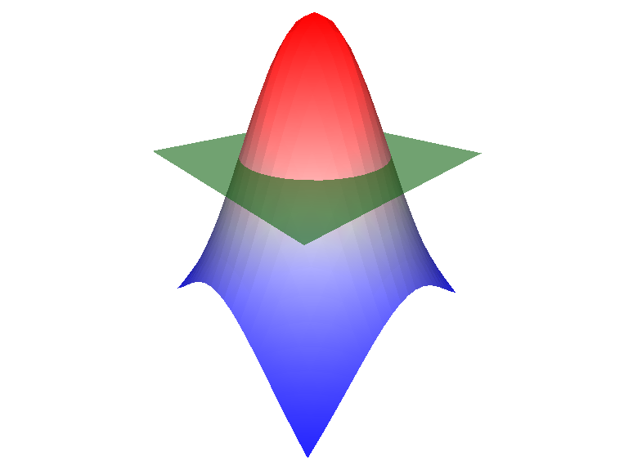
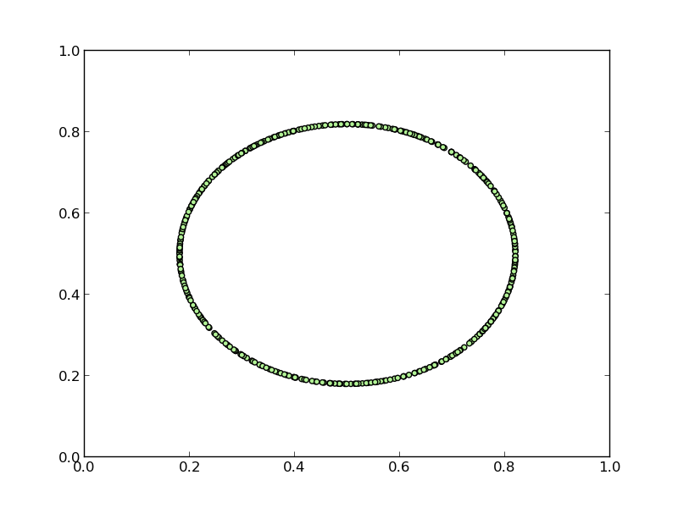
Explore: Limit Surface Adaptive Sampling
Failure region
Limit surface
Notes:
Let me take a brief second to discuss a slightly different problem that nuclear engineers often deal with. Our last study, looked at adaptive sampling with the goal of obtaining a globally accurate fit of the data.
Often in the nuclear accident analysis, they are dealing with simulations where the goal is to understand the frontier that separates recoverable scenarios from system failure scenarios. The frontier we seek is known as the limit surface and the often the goal is to understand the probability of failure which amounts to determining the integral over the failure region.
In order to characterize the limit surface, they often rely on adaptive sampling methods.

Slide 24
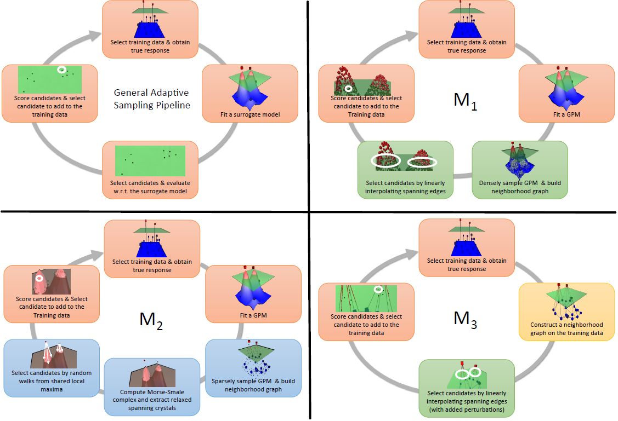
Explore: Limit Surface Adaptive Sampling
Notes:
For the limit surface problem, we actually took a different approach and built three variations of the adaptive sampling pipeline from a prior slide. Two of these methods represent more exploitive models similar to what we have done before, and so in the interest of time, I will highlight what is referred to here as M2.

Slide 25
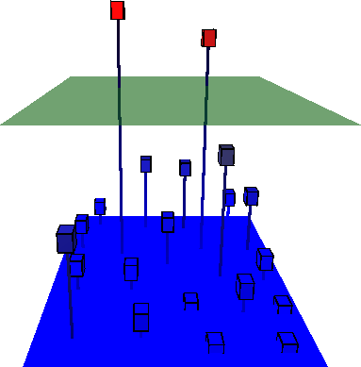
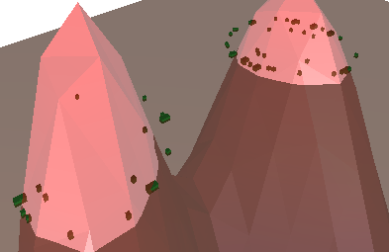
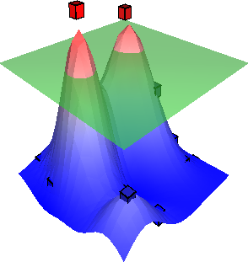
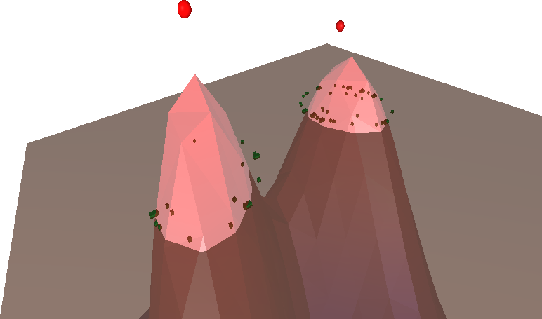
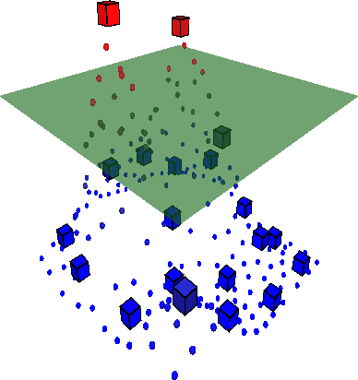
Explore: Limit Surface Adaptive Sampling
Select training data & obtain true response
Score candidates & Select candidate to add to the Training data
Fit a Predicting Model (PM)
Select candidates by random walks from shared local maxima
Sparsely sample PM & build neighborhood graph
Compute Morse complex and extract relaxed spanning crystals
Notes:
This model computes the Morse complex of the data and then utilizes a relaxation parameter to search for partitions in the data that either span or "nearly" span the threshold value. In this way, we can explore regions where the maximum of a dataset may be close to the threshold.

Slide 26
Explore:
Notes:
The last step of the general adaptive sampling pipeline is candidate selection. So far, we have assumed the context of selecting one point before refitting. Under parallel settings, though we can see the benefit of being able to execute several ground truth simulations at once especially since these can take hours or days to complete.
For this, we instead focused our attention on the topology of the scoring landscape rather than the topology of the predicting model. In this way, we can explore distinct topological peaks in the data.
This work is part of a tech report where we compared results in the low-dimensional setting for both global and limit surface problems.

Slide 27
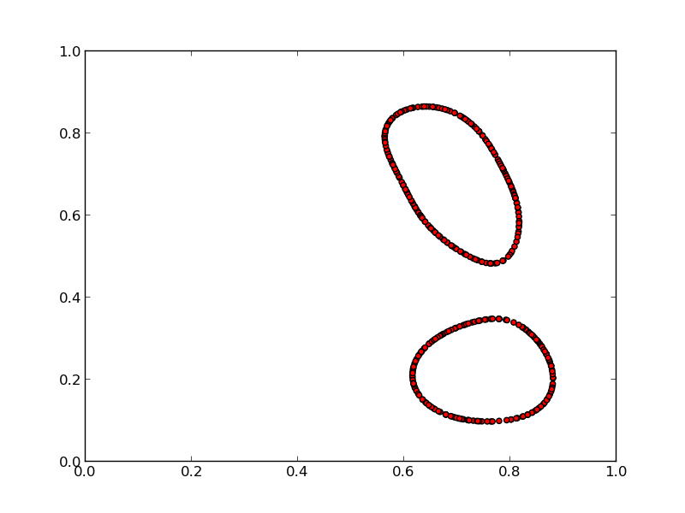
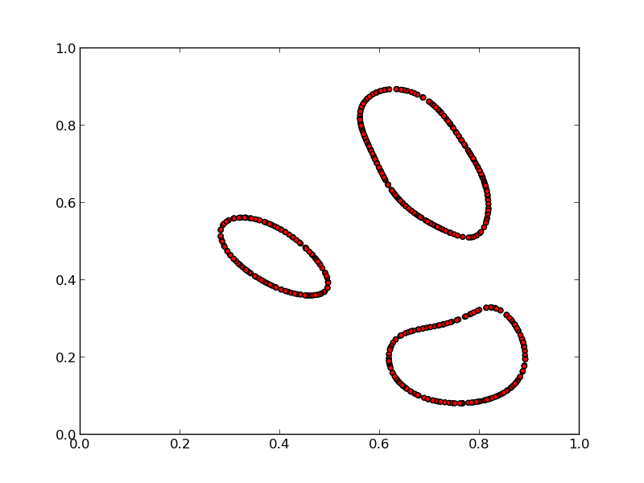
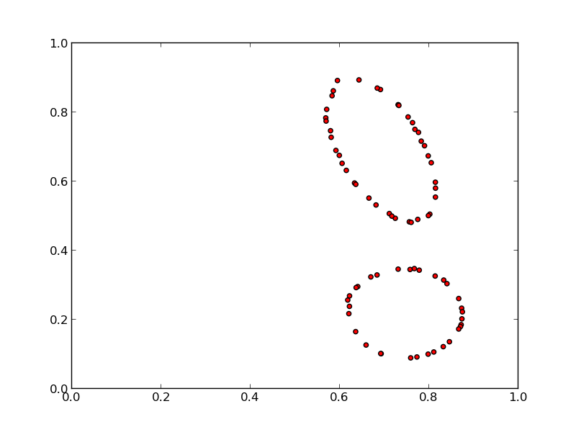
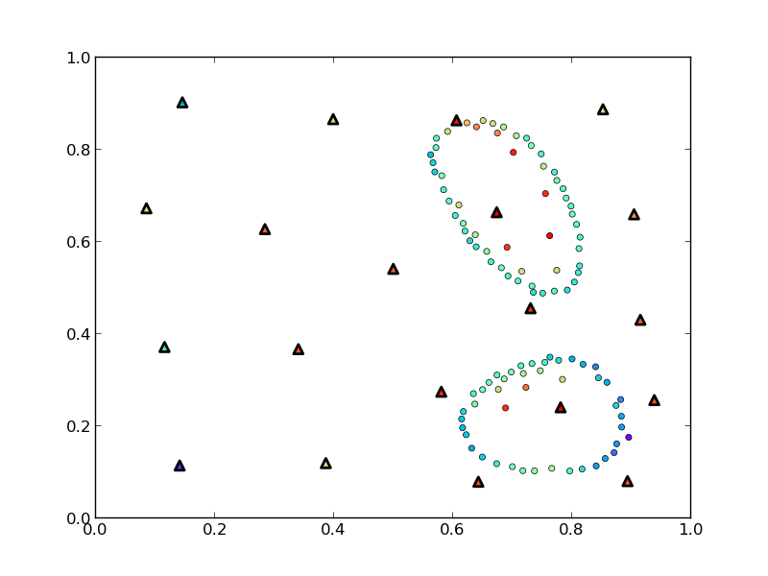
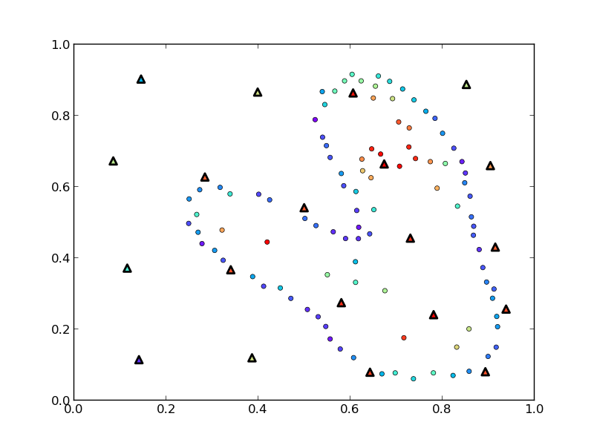
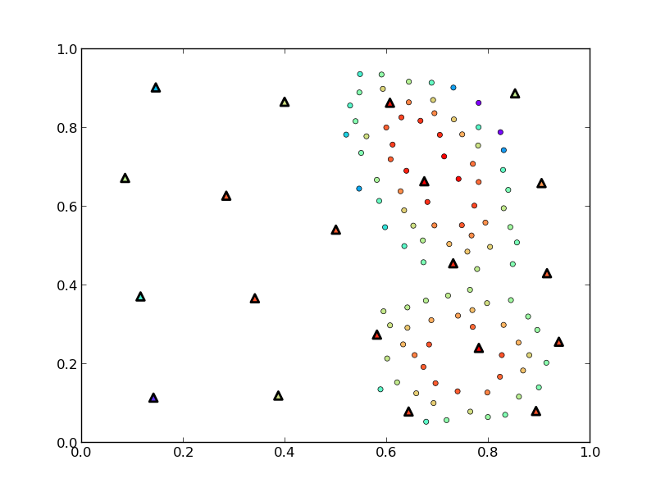
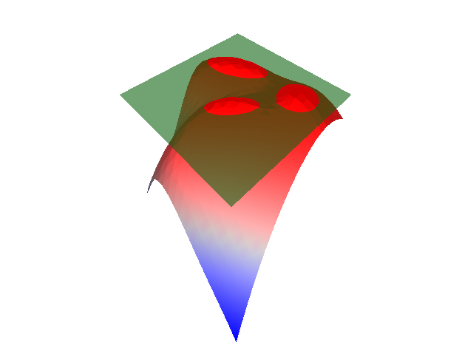
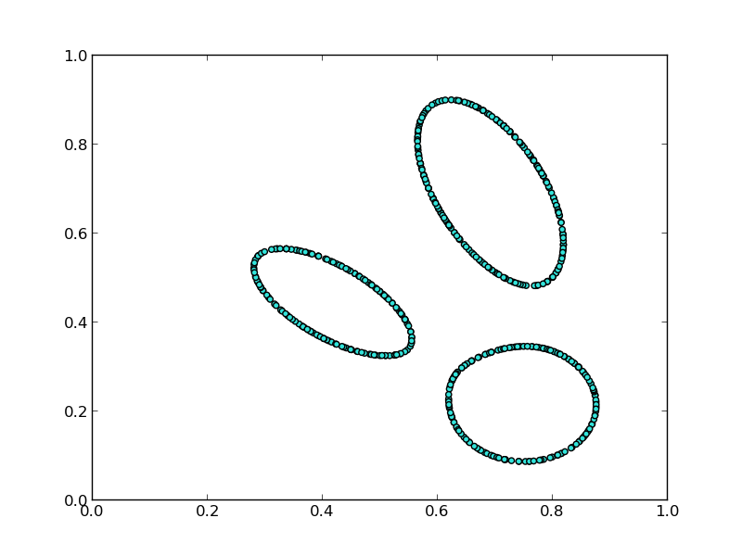
Explore: Limit Surface Adaptive Sampling
Explore vs. Exploit
M1
M2
M3
True Limit Surface
Notes:
We see that with the appropriate relaxation setting, this model is actually able to identify a component of the true limit surface that was not captured in the initial training data.
This work was presented in a nuclear engineering conference and was runner-up for the best student paper award.

Slide 28
Explore:
Notes:
The last step of the general adaptive sampling pipeline is candidate selection. So far, we have assumed the context of selecting one point before refitting. Under parallel settings, though we can see the benefit of being able to execute several ground truth simulations at once especially since these can take hours or days to complete.
For this, we instead focused our attention on the topology of the scoring landscape rather than the topology of the predicting model. In this way, we can explore distinct topological peaks in the data.
This work is part of a tech report where we compared results in the low-dimensional setting for both global and limit surface problems.

Slide 29
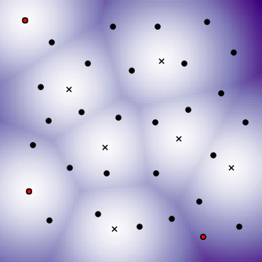
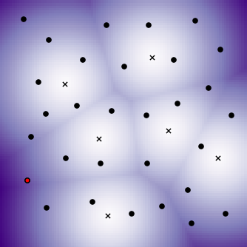
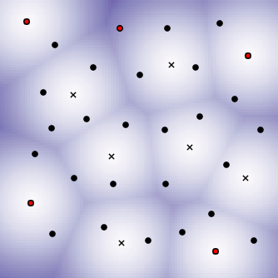
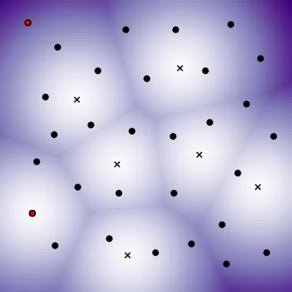
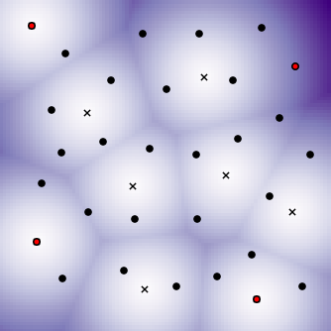
Explore: Candidate Selection
Candidate selection
One-at-a-time
Batch selection
allows running several time-consuming experiments in parallel
Identifying distinct local peaks in the scoring landscape
low score
high score
Training point
Candidate point
Adaptive point
Notes:
The last step of the general adaptive sampling pipeline is candidate selection. So far, we have assumed the context of selecting one point before refitting. Under parallel settings, though we can see the benefit of being able to execute several ground truth simulations at once especially since these can take hours or days to complete.
For this, we instead focused our attention on the topology of the scoring landscape rather than the topology of the predicting model. In this way, we can explore distinct topological peaks in the data.
This work is part of a tech report where we compared results in the low-dimensional setting for both global and limit surface problems.

Slide 30
Explore:
Notes:
The last step of the general adaptive sampling pipeline is candidate selection. So far, we have assumed the context of selecting one point before refitting. Under parallel settings, though we can see the benefit of being able to execute several ground truth simulations at once especially since these can take hours or days to complete.
For this, we instead focused our attention on the topology of the scoring landscape rather than the topology of the predicting model. In this way, we can explore distinct topological peaks in the data.
This work is part of a tech report where we compared results in the low-dimensional setting for both global and limit surface problems.

Slide 31
Analyze: Overview
Proposed solutions:
Structured sensitivity analysis
Approximation errors
Interactive Morse-Smale complex
Input Parameter Candidates
+ Target Output(s)
Analyze
Synthesize
Explore
Scientific Discovery
Enhanced Approximation or Theory
Notes:
We now move on to discuss work being performed in the analysis phase.

Slide 32
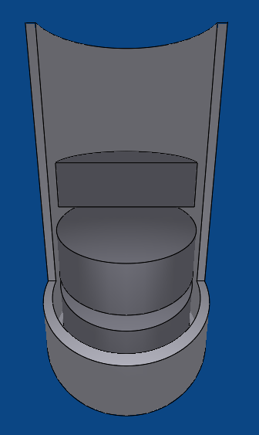
Analyze: Problem Statement
Hydrostatic pressure
Thermal expansion
Fission gas swelling
Power scaling
Contact point
Equilibrium point
What drives the stress?
Notes:
Here, we investigate the problem of designing safer nuclear fuels. So, we investigate a simulation that looks at understanding the maximum stress occurring in the shielding that surrounds a nuclear fuel rod undergoing normal operation.
There are several different parameters of the fuel rod that interact with this stress in the system, and the scientists were interested in studying what drives the stress by performing sensitivity analysis, however we identified this problem as being ill-suited for a global sensitivity study due to the non-monotonic nature of the input. So, we needed to develop a method that was more amenable to this situation.

Slide 33
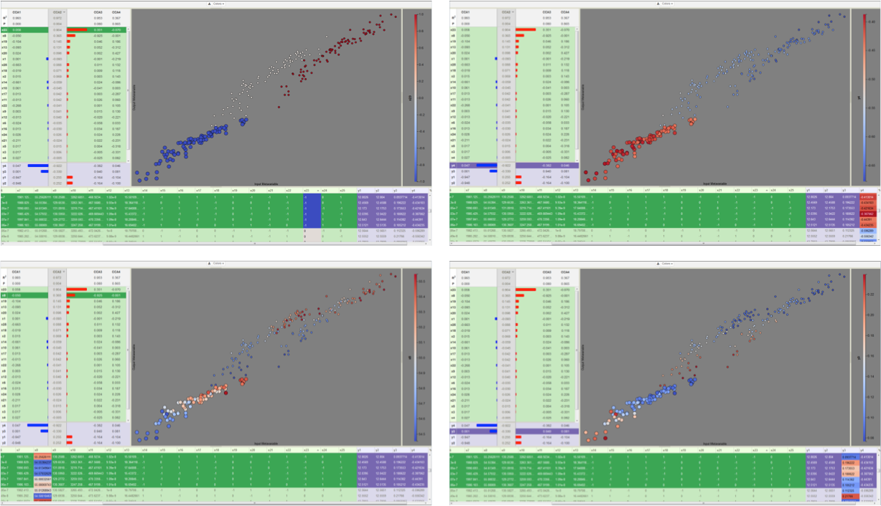
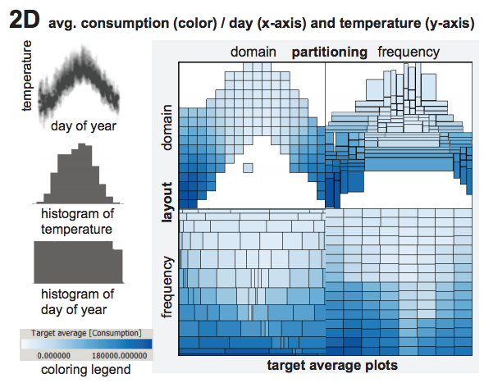
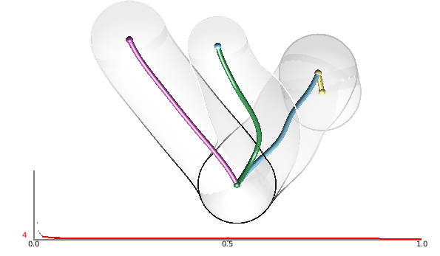
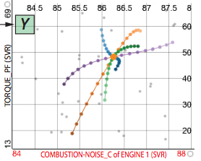
Analyze: Sensitivity Analysis in Visualization
Global SA
Structured SA
Summary metrics over entire data
First step for further exploration
Partition data, then analyze
Handles non-monotonic data
Provides per partition summary
Crossno et al. 2015
Local SA
Sensitivity centered around focal point
Drilldown tasks
Muhlbacher and Piringer 2013
Complicated
Gerber et al. 2011
Berger et al. 2011
Notes:
So, typically the first go-to is a global sensitivity study and we have seen methods in visualization that do this for arbitrary input dimensions. These methods are great for parameter screening, however these types of methods struggle on non-monotonic data unless higher order methods are used, but these lack the direct interpretability of simple partial derivative type information.
On the other hand, local sensitivity analysis looks at a user-defined focal point giving a much more local and on-demand view of the information. These methods are better suited for drilldown techniques such as when one has identfied an area of interest or in optimization settings.
In terms of structured sensitivity, there has been past work, but these rely on 1 or 2D axis-aligned cuts of the data. The exception being the use of the Morse-Smale complex by Sam Gerber et al. which is where we want to focus our attention.
Here, I am highlighting the 2011 work that developed this software called HDViz. I utilized this technique in some of my earlier analysis with nuclear engineers, however after several iterations the nuclear engineers still relied heavily on expert users of the system, and so the idea of this work was to develop something intuitive and usable by the domain scientists directly.

Slide 34
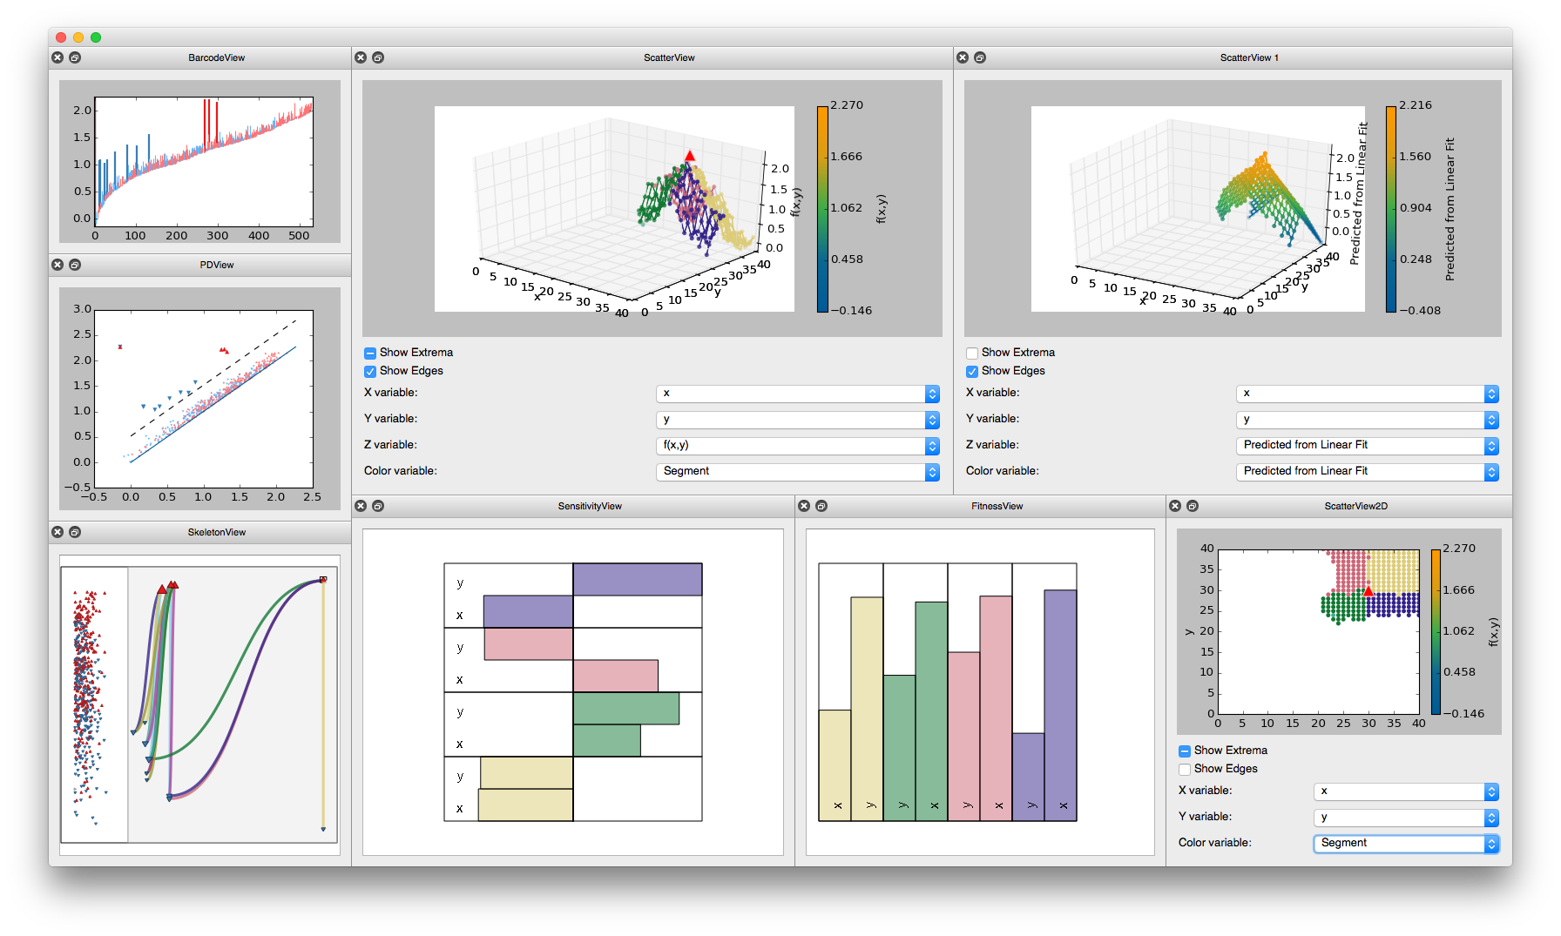
Analyze: Structured SA in RAVEN
Sensitivity coefficients:
Linear
Pearson
Spearman rank
Stepwise Fitness:
Coefficient of determination (R²)
New Topology map
Notes:
I then started working at INL and performed an informal design study with a team of nuclear engineers focusing on the problem space they were interested in explicitly and how we could design visual metaphors that optimized their time using the software. The result of that design study is shown on this slide, namely a MCV piece of software explicitly for sensitivity analysis and parameter screening tasks.

Slide 35
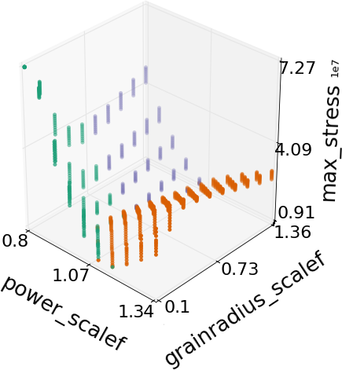
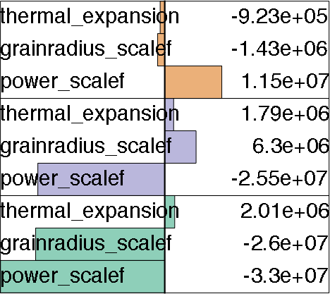
Analyze: SA Anomaly for Nuclear Fuel
?
Sign of thermal expansion coefficient sensitivity is reversed to the expected result
Conclusion: Simulation input is incorrectly coded.
Analyze
Synthesize
Explore
Scientific Discovery
Notes:
So, the engineers used this tool to analyze the nuclear fuel data from before, and within 10 minutes, they were able to select an appropriate partition level and identified an anomaly in the data with respect to their expectation. The sign of one of the parameters was actually inverse of what they had expected, and so, we looked more closely at one of the simulations and noted that there was an error in the input deck that we were perturbing in order to generate this dataset.
It is important to note that in this process we cycled through an entire iteration of the experimental design process where we were able to identify an error and correct. For the sake of time, I am going to omit the corrected analysis on this data.

Slide 36
Analyze:
Notes:
Here, we investigate the problem of designing safer nuclear fuels. So, we investigate a simulation that looks at understanding the maximum stress occurring in the shielding that surrounds a nuclear fuel rod undergoing normal operation.
There are several different parameters of the fuel rod that interact with this stress in the system, and the scientists were interested in studying what drives the stress by performing sensitivity analysis, however we identified this problem as being ill-suited for a global sensitivity study due to the non-monotonic nature of the input. So, we needed to develop a method that was more amenable to this situation.

Slide 37
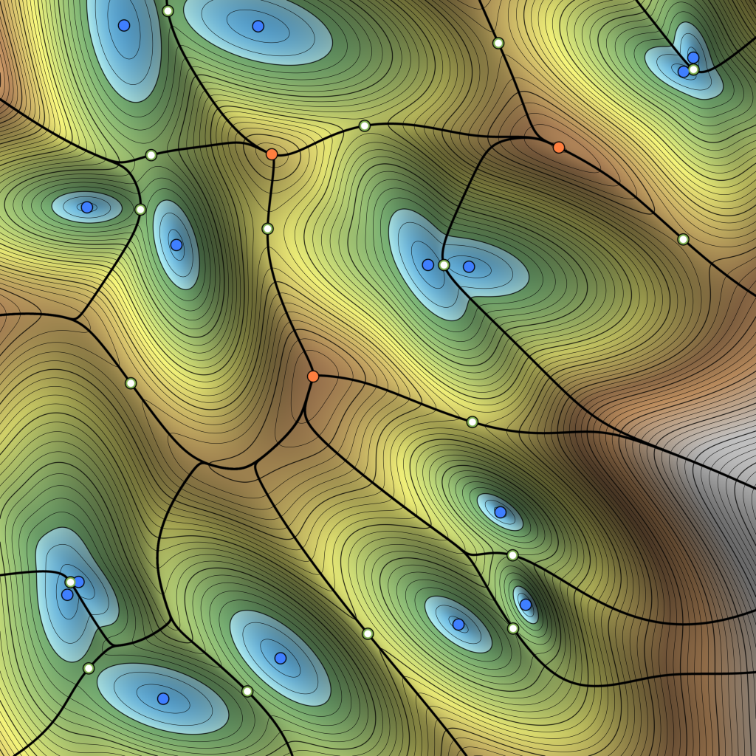
Analyze: Morse-Smale Approximation Errors
Recall the Morse-Smale Complex:
What if we do not have a smooth representation?
Notes:
When evaluating this data, it is important to not that we are using an approximation of the Morse-Smale complex dependent on the amount of data we have. That is, we approximate gradient flow based on a neighborhood graph imposed on the data.

Slide 38
Analyze: Morse-Smale Approximation Errors
Recall the Morse-Smale Complex:
What if we do not have a smooth representation?
Extraneous extrema due to under-connected graph
Notes:
This can lead to one of two problems in the approximation. The first is the result of having too few edges in the data. In the extreme case, this will create islands of data that are disjoint and unable to be analyzed, however the more common case results in spurious extrema as shown here.
In many cases, we can alleviate this problem with persistence simplifcation, but only if the feature scale is small.

Slide 39
Analyze: Morse-Smale Approximation Errors
Recall the Morse-Smale Complex:
What if we do not have a smooth representation?
Missed extrema due to over-connected graph
Notes:
The other case results from an over-connected graph which completely misses the existence of extrema by edges that basically "skip over" saddle locations.
We performed several empirical tests on 2-5D test cases which were compiled into a Workshop paper in 2013.

Slide 40
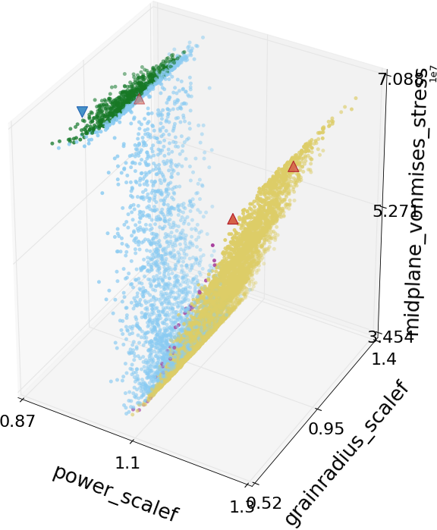
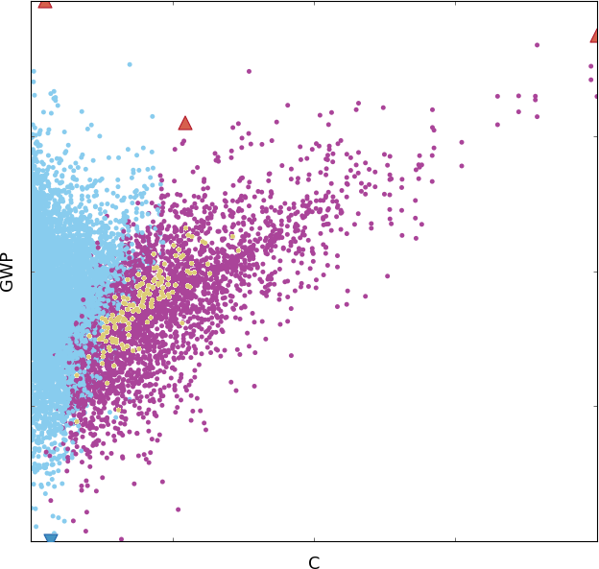
Analyze: Morse-Smale Approximation Errors
Synthesize: We Need a Better Data Model
Nuclear Fuel Data
Hydrology Data
Notes:
In two different real world datasets, one of which we have seen already, the domain scientists discovered partitions they did not expect, and upon closer inspection appeared to be the result of poor sampling density in the regions of interest.
In this way, persistence simplification alone is unable to remove such features from the data.
One avenue of proposed work yet to be completed is to call attention to such problems and rely on a more user-guided interaction of the topology that allows them to explore certain branches of the hierarchy in exclusion and augment them manually if necessary.
In addition, I would like to explore the idea of further decomposing the monotonic patches of the Morse-Smale complex since monotonicity does not ensure an accurate linear fit.

Slide 41
Analyze: Morse-Smale Approximation Errors
Synthesize: Can We Improve the Graph?
Everything is built off of the NGL library (Correa and Lindstrom) which prunes an empty region graph from a KNN supergraph
What other graphs can we use?
Scalability?
What else are these graphs good for?
Notes:
In two different real world datasets, one of which we have seen already, the domain scientists discovered partitions they did not expect, and upon closer inspection appeared to be the result of poor sampling density in the regions of interest.
In this way, persistence simplification alone is unable to remove such features from the data.
One avenue of proposed work yet to be completed is to call attention to such problems and rely on a more user-guided interaction of the topology that allows them to explore certain branches of the hierarchy in exclusion and augment them manually if necessary.
In addition, I would like to explore the idea of further decomposing the monotonic patches of the Morse-Smale complex since monotonicity does not ensure an accurate linear fit.

Slide 42
Synthesize: What Other Graphs Can We Use?
Delaunay Triangulation
Can create long edges on the boundary of domain
Number of points on the boundary increases with dimensionality
Curse of dimensionality

Slide 43
Synthesize: What Other Graphs Can We Use?
Delaunay Triangulation
k-Nearest Neighborhood
Using ANN (approximate kNN) Mount and Arya, 2010
k is sensitive to dimensionality and density of points
(can be hard to get right)

Slide 44
Synthesize: What Other Graphs Can We Use?
Delaunay Triangulation
k-Nearest Neighborhood
β-Skeletons:
β<1
p
q

Slide 45
Synthesize: What Other Graphs Can We Use?
Delaunay Triangulation
k-Nearest Neighborhood
β-Skeletons:
β<1
β=1 (Gabriel Graph)
p
q

Slide 46
Synthesize: What Other Graphs Can We Use?
Delaunay Triangulation
k-Nearest Neighborhood
β-Skeletons:
β<1
β=1 (Gabriel Graph)
1<β<2
β=2 (Relative Neighbor Graph)
*Increasing β,
Decreases edge density
p
q

Slide 47
Synthesize: What Other Graphs Can We Use?
Delaunay Triangulation
k-Nearest Neighborhood
β-Skeletons:
β<1
β=1 (Gabriel Graph)
1<β<2
β=2 (Relative Neighbor Graph)
Relaxed β-Skeletons
Relaxed β<1
Relaxed Gabriel Graph
Relaxed 1<β<2
Relaxed Relative Neighbor Graph
*Increasing β,
Decreases edge density
c
b
a

Slide 48
Analyze: Morse-Smale Approximation Errors
Synthesize: Cone Graphs
Notes:
In two different real world datasets, one of which we have seen already, the domain scientists discovered partitions they did not expect, and upon closer inspection appeared to be the result of poor sampling density in the regions of interest.
In this way, persistence simplification alone is unable to remove such features from the data.
One avenue of proposed work yet to be completed is to call attention to such problems and rely on a more user-guided interaction of the topology that allows them to explore certain branches of the hierarchy in exclusion and augment them manually if necessary.
In addition, I would like to explore the idea of further decomposing the monotonic patches of the Morse-Smale complex since monotonicity does not ensure an accurate linear fit.

Slide 49
Analyze: Morse-Smale Approximation Errors
Synthesize: β_{p}-Skeletons
Notes:
In two different real world datasets, one of which we have seen already, the domain scientists discovered partitions they did not expect, and upon closer inspection appeared to be the result of poor sampling density in the regions of interest.
In this way, persistence simplification alone is unable to remove such features from the data.
One avenue of proposed work yet to be completed is to call attention to such problems and rely on a more user-guided interaction of the topology that allows them to explore certain branches of the hierarchy in exclusion and augment them manually if necessary.
In addition, I would like to explore the idea of further decomposing the monotonic patches of the Morse-Smale complex since monotonicity does not ensure an accurate linear fit.

Slide 50
Analyze: Morse-Smale Approximation Errors
Synthesize: Graph Scalability
Starting with a KNN supergraph…
Prune based on specific criteria

Slide 51
Synthesize: Evaluation
Case Study 1:
Evaluate Graph Quality in 2D
Determine diagnostic measures for “good” graphs
Case Study 2:
Evaluate ability to recover topology in higher dimensional settings
Use well-described test functions
Case Study 3:
Evaluate ability in machine learning pipeline by reducing data in classification problem
Two real-world datasets in 12 and 16 dimensions
Trade-off analysis of accuracy vs. data reduction
Analyze
Synthesize
Explore
Scientific Discovery
Notes:
So, the engineers used this tool to analyze the nuclear fuel data from before, and within 10 minutes, they were able to select an appropriate partition level and identified an anomaly in the data with respect to their expectation. The sign of one of the parameters was actually inverse of what they had expected, and so, we looked more closely at one of the simulations and noted that there was an error in the input deck that we were perturbing in order to generate this dataset.
It is important to note that in this process we cycled through an entire iteration of the experimental design process where we were able to identify an error and correct. For the sake of time, I am going to omit the corrected analysis on this data.

Slide 52
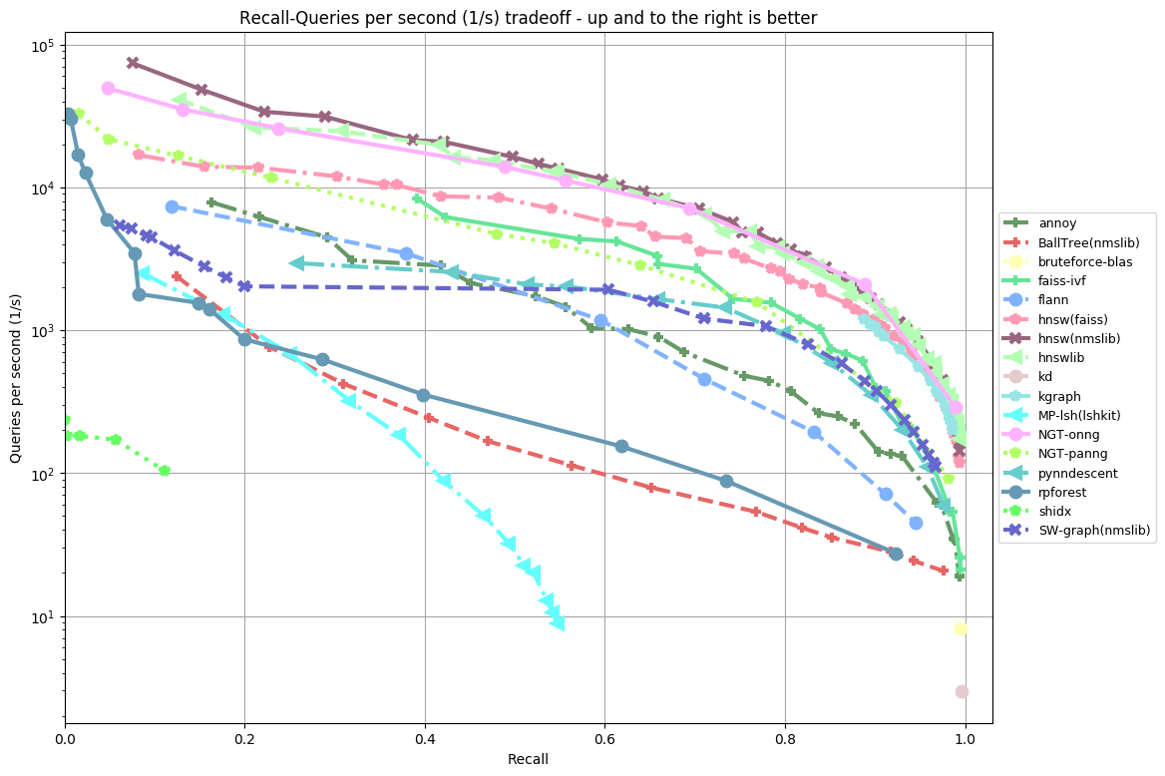
Analyze: Morse-Smale Approximation Errors
Synthesize: Approximate KNN Graphs
Publicly available benchmark that evaluates 20+ ANN implementations

Slide 53
Synthesize: Performance Gains

Slide 54
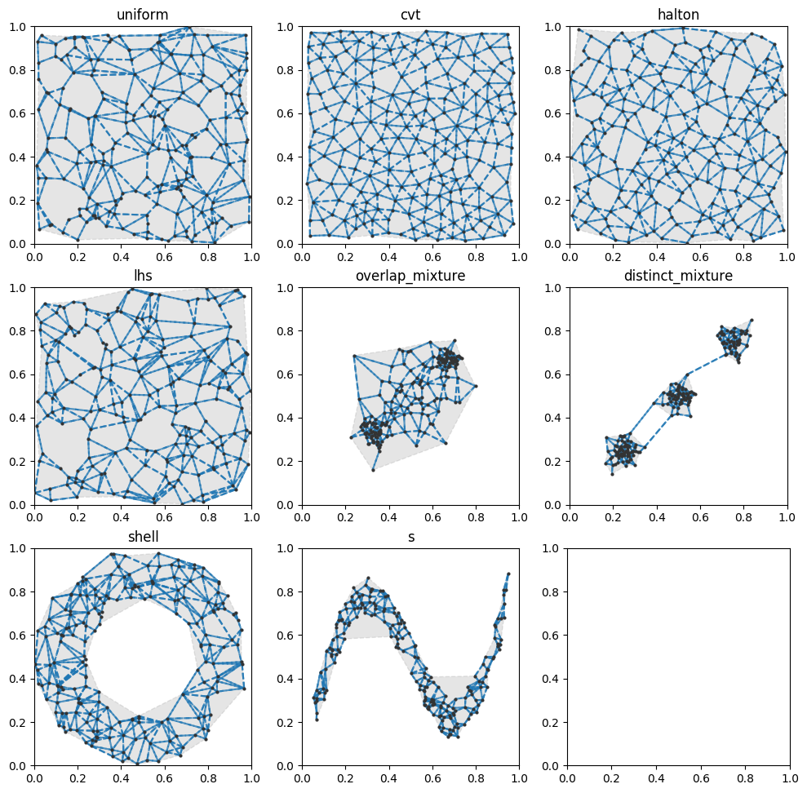
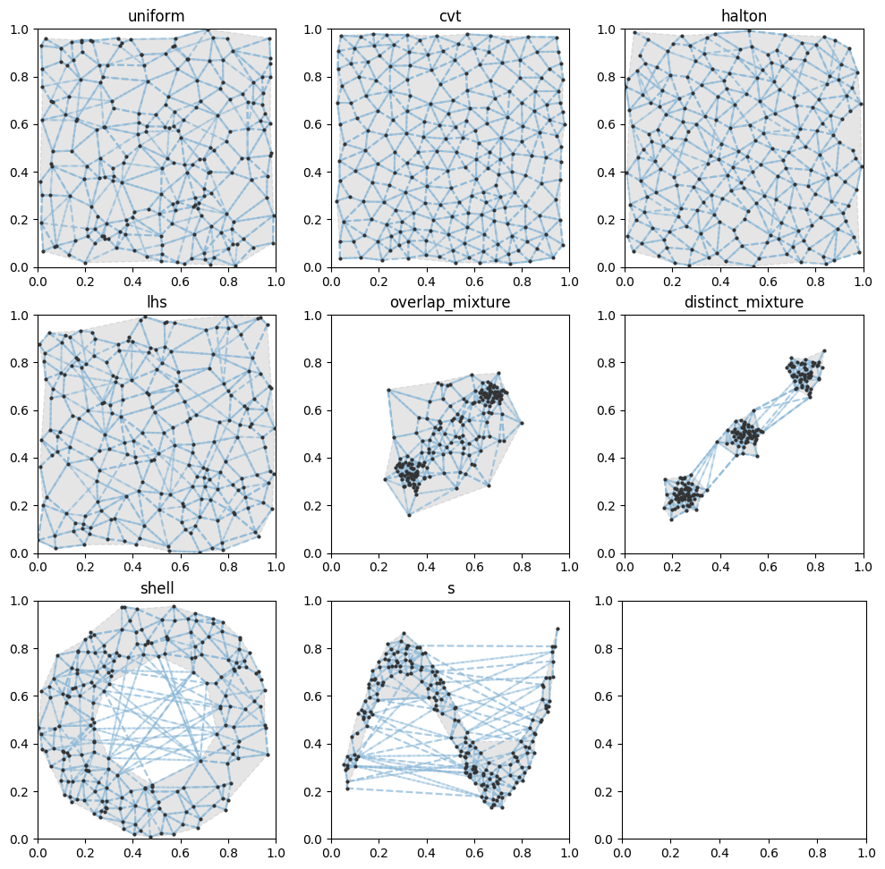



Case Study 1: 2D Graph Quality

Slide 55
Case Study 2: Topological Stability

Slide 56
Case Study 3: Classification Training Reduction

Slide 57



Performance Metric Definition
*Let m_{true} be the number of true minima and m_{reported} be the number of minima identified
Precision - Do we introduce any false minima?
Recall - How well can we identify true minima?
Eg.
= true
= reported
P = 2 / 4
R = 2 / 3

Slide 58
Synthesize: Topological Performance Metric
*Let m_{true} be the number of true minima and m_{reported} be the number of minima identified
Precision - Do we introduce any false minima?
Recall - How well can we identify true minima?
Eg.
= true
= reported
P = 2 / 4
R = 2 / 3

Slide 59

Synthesize: Topological Performance Metric
Precision - Do we introduce any false extrema?
Underconnected graph
Can conceal with persistence simplification
Recall - How well can we identify true extrema?
Overconnected graph

Slide 60




Synthesize: NGLPy Performance Gains
Scalable Nearest Neighbor Query Structure
N=10,000
N=100,000
N=1,000,000
Prune Time
2
3
4
5
6
7
2
3
4
5
6
7
2
3
4
5
6
7
Dimensionality

Slide 61


Synthesize: A New Suite of Libraries for Analysis
Scalable Nearest Neighbor Query Structure
Regulus

Slide 62
Thank You
Input Parameter Candidates
+ Target Output(s)
Analyze
Synthesize
Explore
Scientific Discovery
Enhanced Approximation or Theory
IPyRegulus

